Slide 1

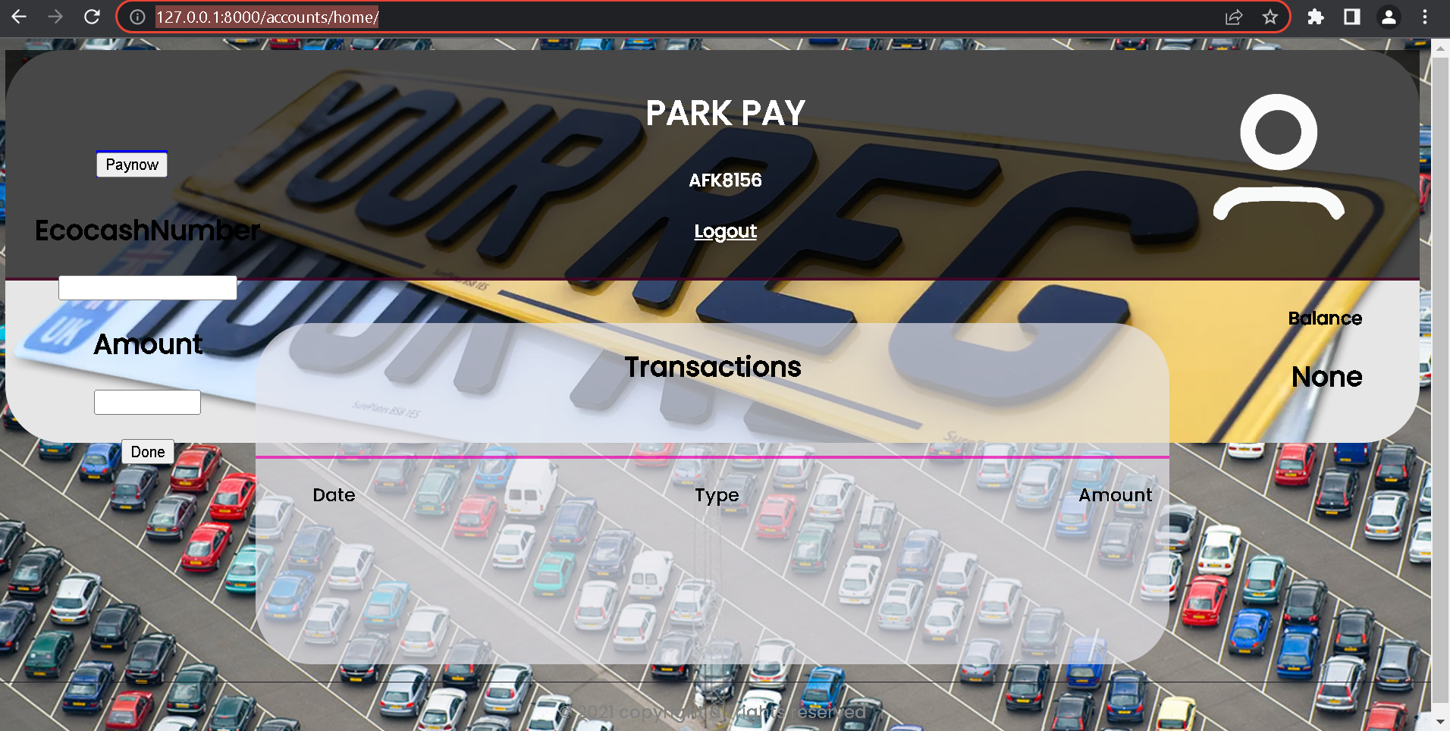
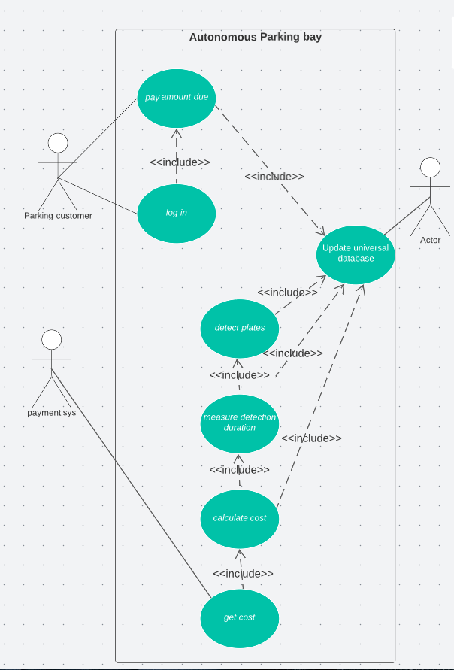
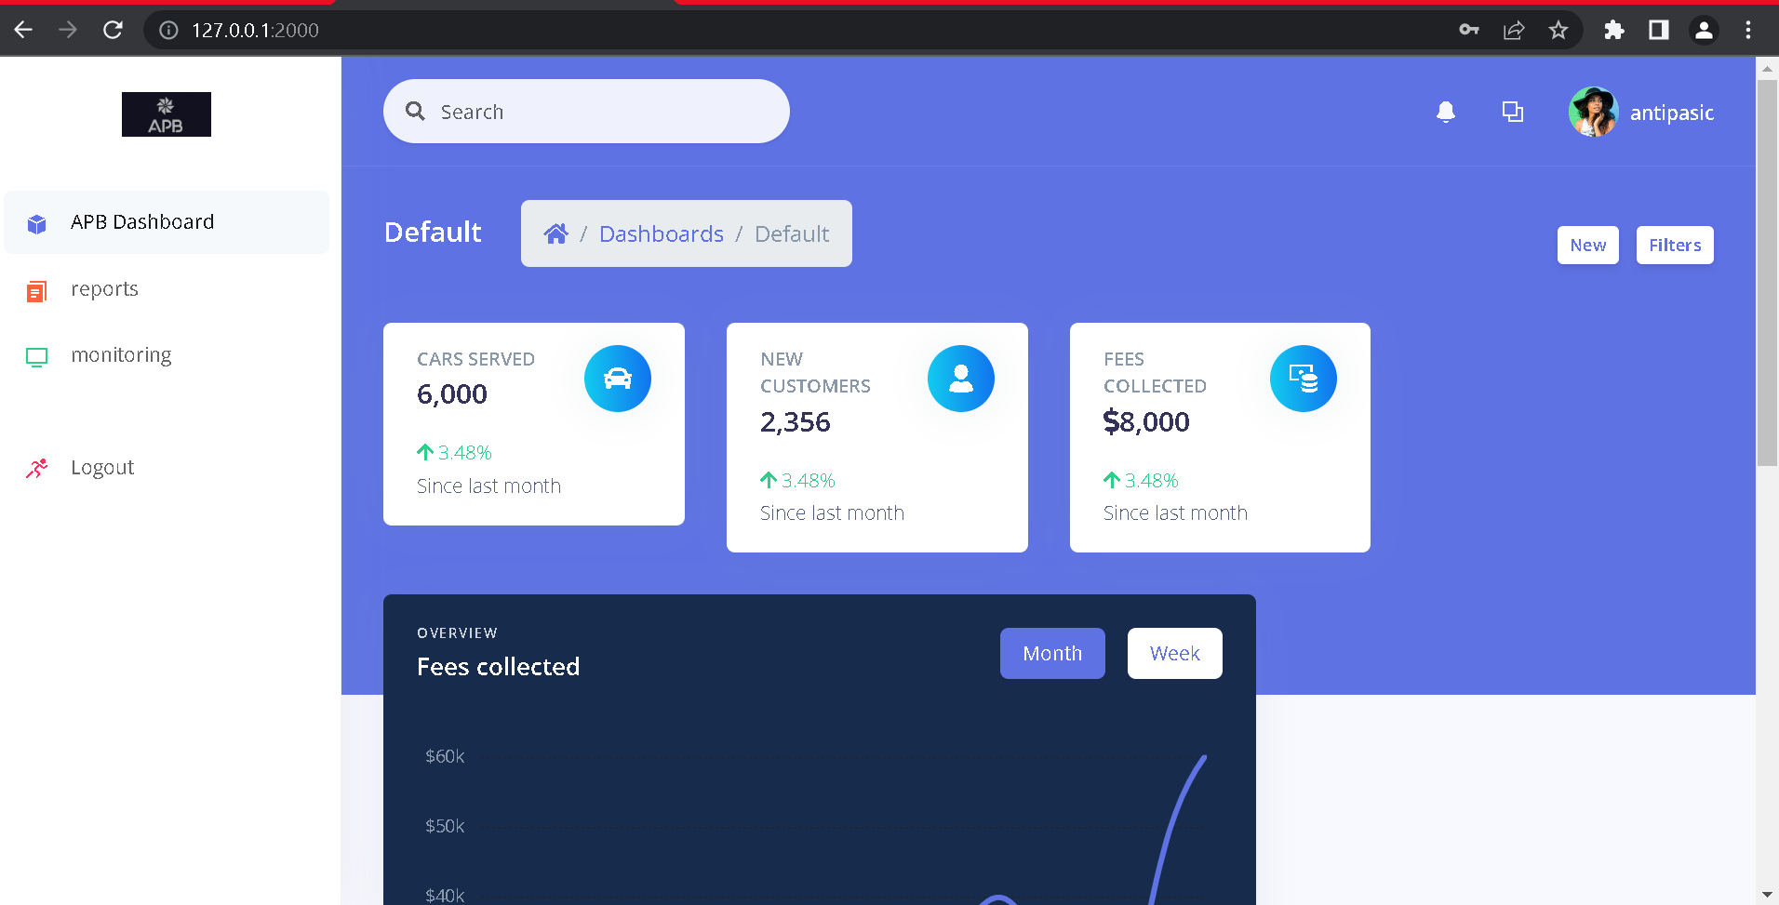
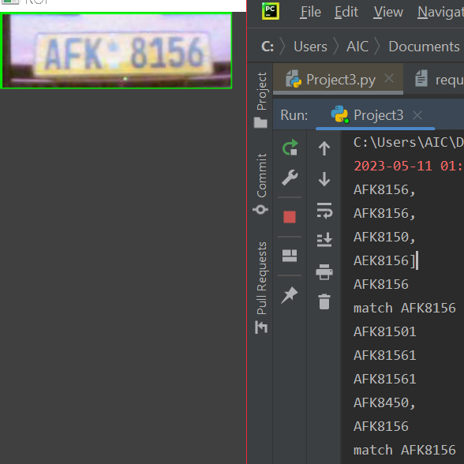
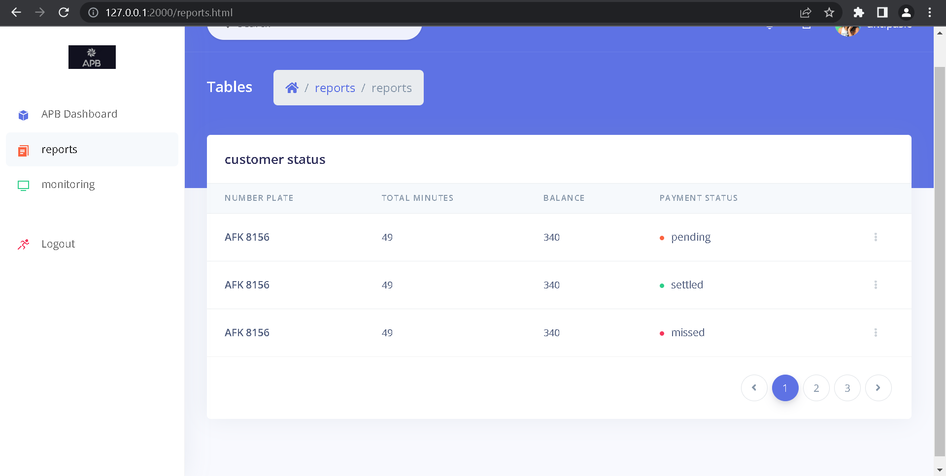
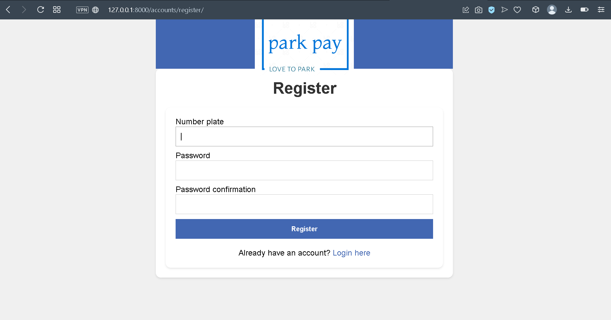
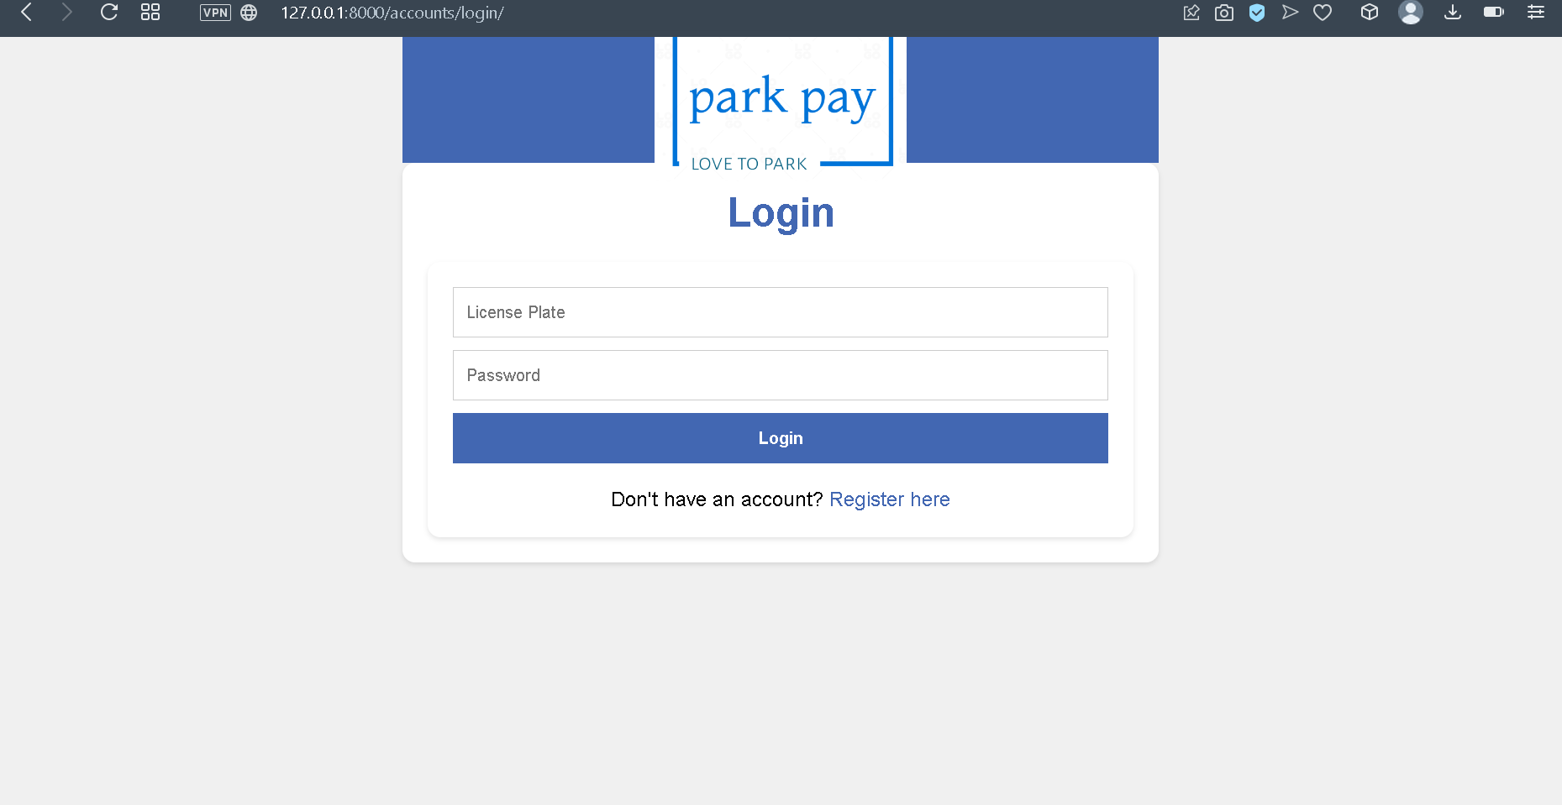
Autonomous Parking Bay
Antipas Chinodakufa - Software Engineering Department
1.0 Abstract
3.0. Problem definition
7.0. Use Case Diagram
This project aims to design and implement an autonomous parking system that uses automatic number plate recognition (ANPR) and a payment platform to manage parking services for any owner of parking space in Zimbabwe. The current parking system relies on manual processes and human intervention, which are prone to errors, frauds, inefficiency, inconvenience, and high costs. The proposed parking system uses a camera and an optical character recognition (OCR) algorithm to scan the number plate of a car and start a timer when it enters a parking bay. The system also queries a database for the customer account associated with the number plate and updates it with the parking cost and records the car service and fee information. The customer can pay for the parking using PayNow, a third-party payment platform that is integrated with the payment system. The reporting system retrieves the car service and fee information from the database and generates a report of the parking activity. The objectives of this project are: 1) to detect a number plate of a vehicle on a parking bay; 2) to record the duration parked by a vehicle; 3) to calculate the parking cost based on the duration; and 4) to allow a customer to pay the parking fee after parking. The proposed parking system is expected to reduce errors and frauds, improve efficiency and speed, enhance convenience and safety for customers, lower costs and labour, and provide accurate and reliable data for reporting and analysis. The project will use appropriate software tools and techniques to design, develop, test, and implement the proposed parking system.
The current parking system in Harare is outdated and inefficient. It has several drawbacks, such as human errors and frauds, inefficiency and time-consumption. It is inconvenient, costly, labour-intensive and lacks accurate and reliable data. It relies on manual processes and human intervention to identify cars and licence plates, collect payments, produce receipts, and keep track of time. There is a need for a new parking system that can overcome the drawbacks of the current system and provide a better parking experience for both the customers and the parking business. The proposed parking system uses technology to automate the parking process. It consists of a Detection System, a Database, a Payment System, and a Reporting System that scan the plates, calculate the fee, allow online payment, and provide data for reporting and analysis.
4.0. Overview of the developed application
The system is an autonomous parking bay that uses computer vision and licence plate recognition AI models to automate the parking management process.
It detects the number plates of parked vehicles, measures the parking duration, calculates the parking fees, and updates the customer accounts in a database. It also allows customers to pay online using PayNow4, a third-party payment platform, and generates reports of the parking activity for monitoring and analysis.
The system aims to reduce human errors, miscalculations, and corruption in the parking industry.
8.0. Screenshots
2.0. Introduction
Parking is an essential service for any urban area, especially for supermarkets that attract a large number of customers. However, parking systems in Zimbabwe are mostly human intensive and manual, which leads to various problems such as errors, frauds, inefficiency, inconvenience, high costs, and poor data quality. To address these problems, this paper proposes an autonomous parking system that uses automatic number plate recognition (ANPR) and a payment platform to manage parking services for any owner of parking space in Zimbabwe. The system uses a camera and an optical character recognition (OCR) algorithm to scan the number plate of a car and start a timer when it enters a parking bay. The system also queries a database for the customer account associated with the number plate and updates it with the parking cost and records the car service and fee information. The customer can pay for the parking using PayNow, a third-party payment platform that is integrated with the system. The system also generates a report of the parking activity using the data from the database. The system aims to reduce errors and frauds, improve efficiency and speed, enhance convenience and safety for customers, lower costs and labor, and provide accurate and reliable data for reporting and analysis.
5.0. Objectives
To detect a number plate of a vehicle on a parking bay.
To record the duration parked by a vehicle that is, from when a car is in site to when it leaves the parking bay.
To calculate the parking cost from the moment its number plate is dictated to the moment it leaves a parking bay.
To allow a customer to pay the parking fee after parking.
Conclusion
6.0. System Overview
The current parking system is human intensive with two or more parking attendants at a single parking bay. They collect fees, note vehicle license plates and keep time. This system is therefore prone to errors, frauds and is generally inefficient. This was the basis for undertaking such a project to correct the inefficiencies.
The solution is an Autonomous parking system that depends on ANPR and a universal database. The system comprises of four parts the payment system (ParkPay), the detection system, the reporting system and the universal database. The tools used to implement the system were OpenCV, EasyOCR, PostgreSQL, python and Django Framework.
The system passed the system testing and has shown that there can exist an autonomous parking bay.
Supervisor – Mr. W. Makondo

